Slide 1

Chapter 5
Hang on Every Word

Slide 2
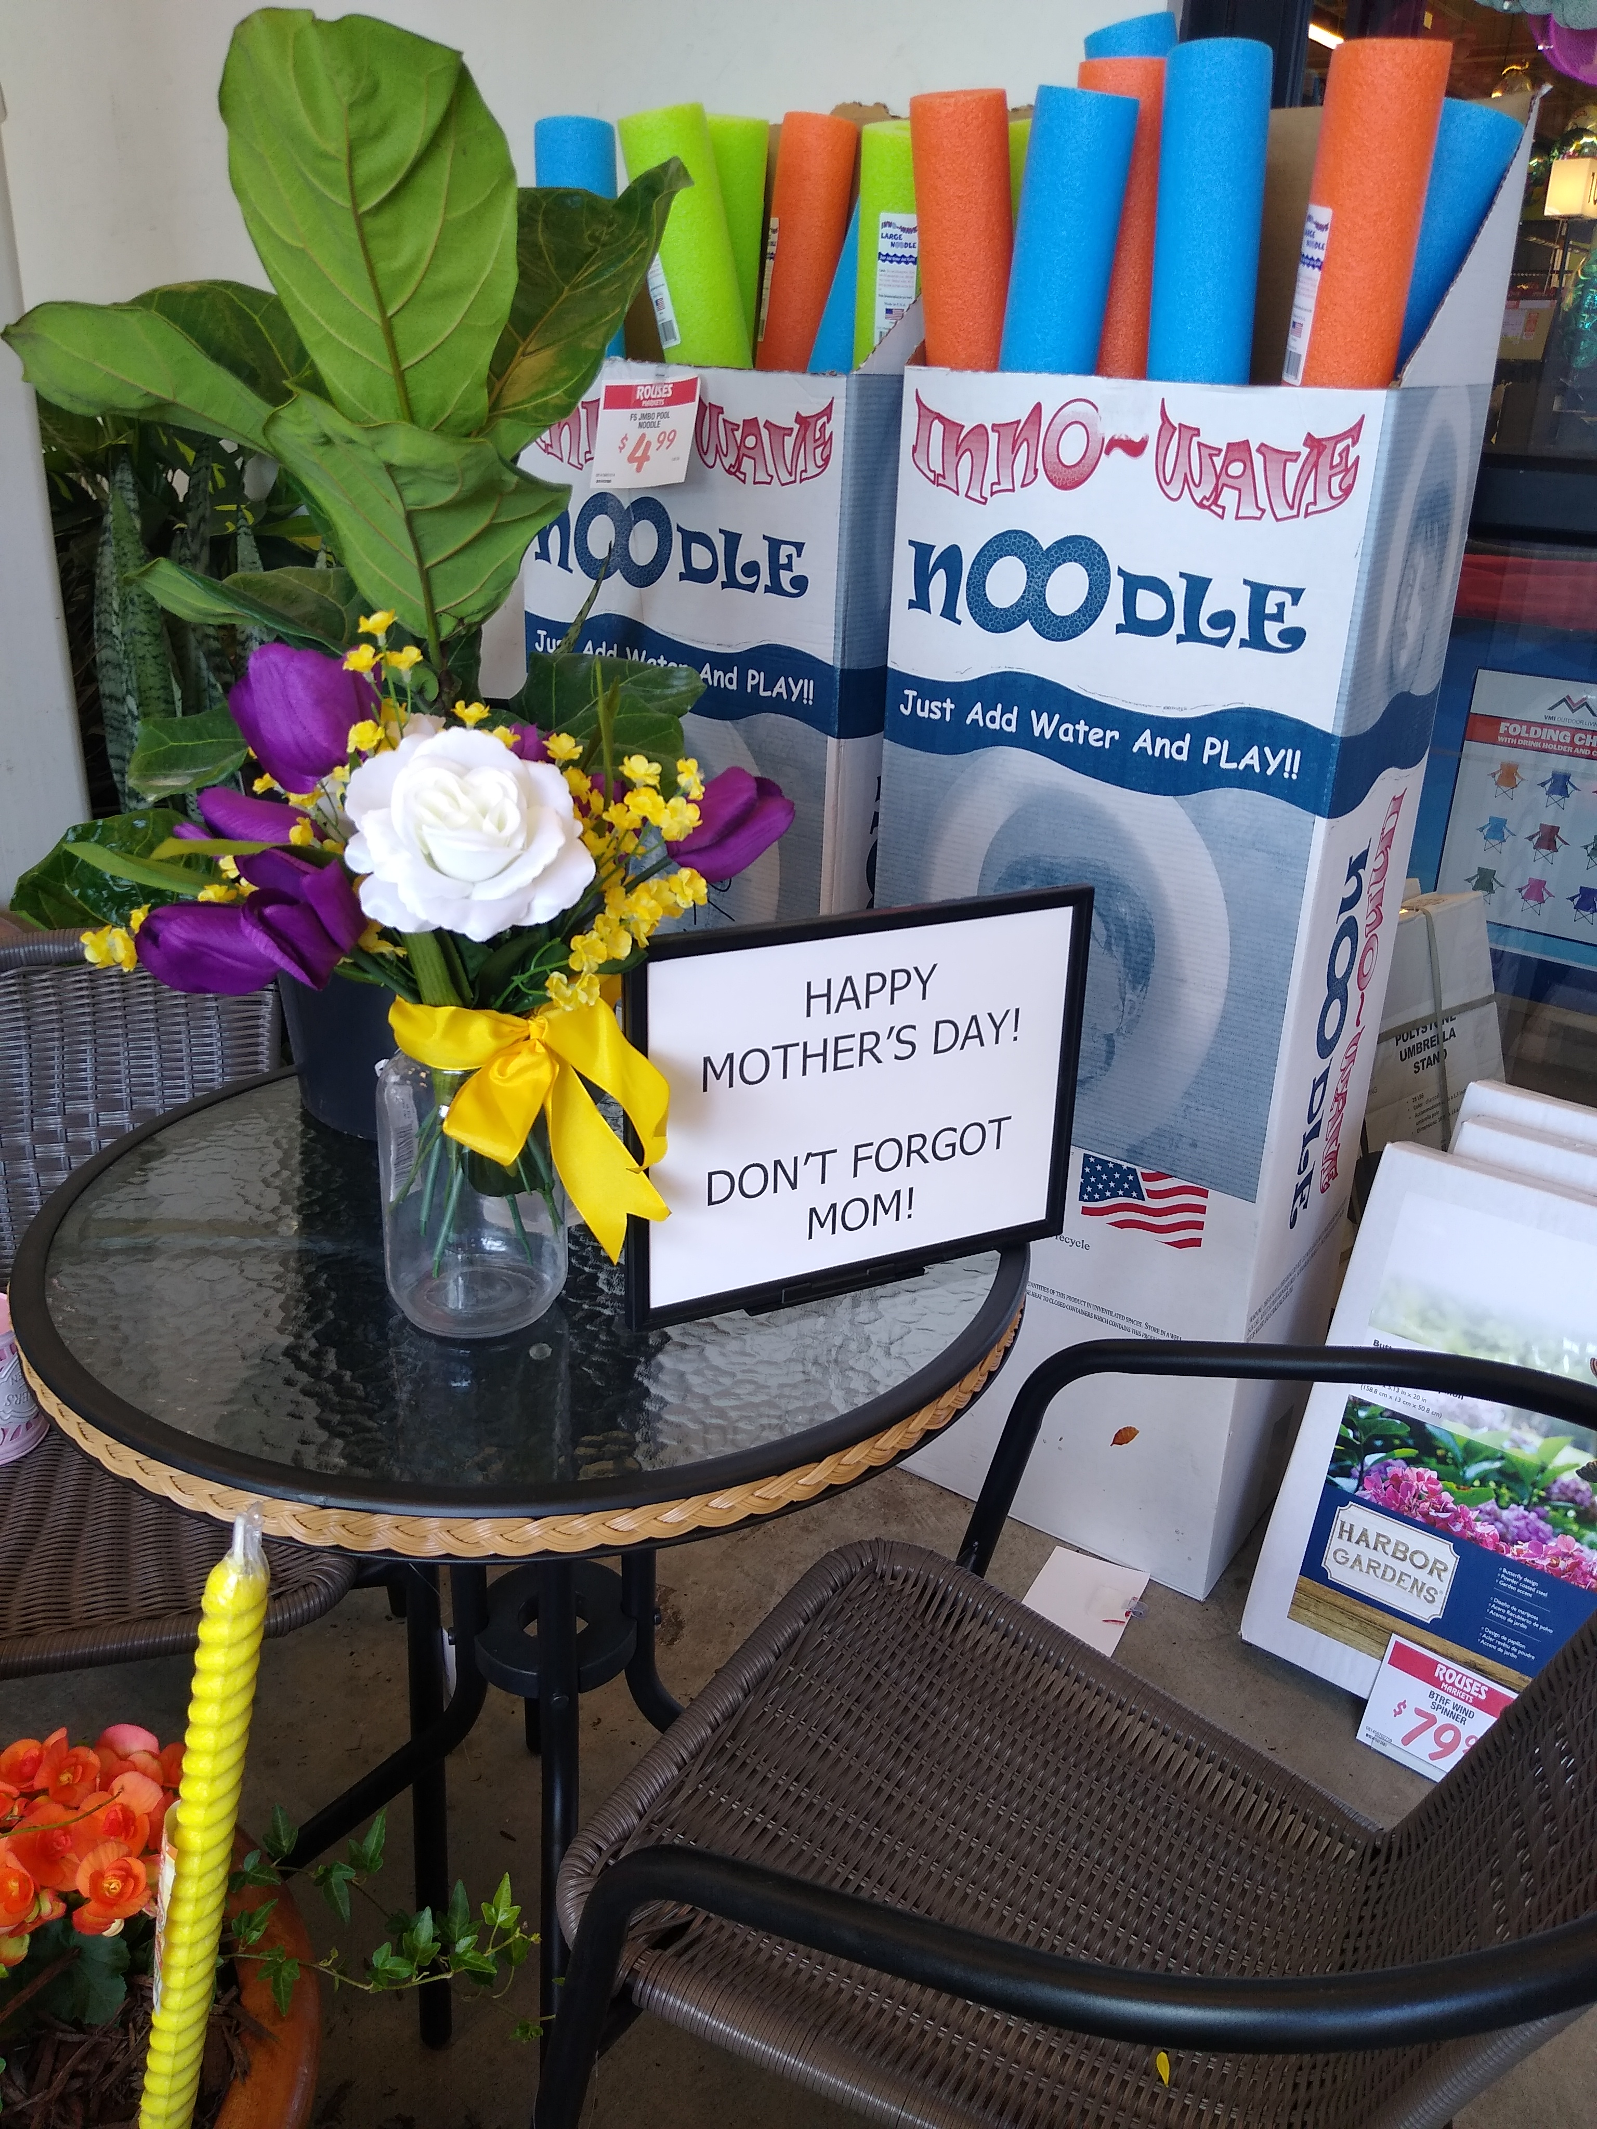
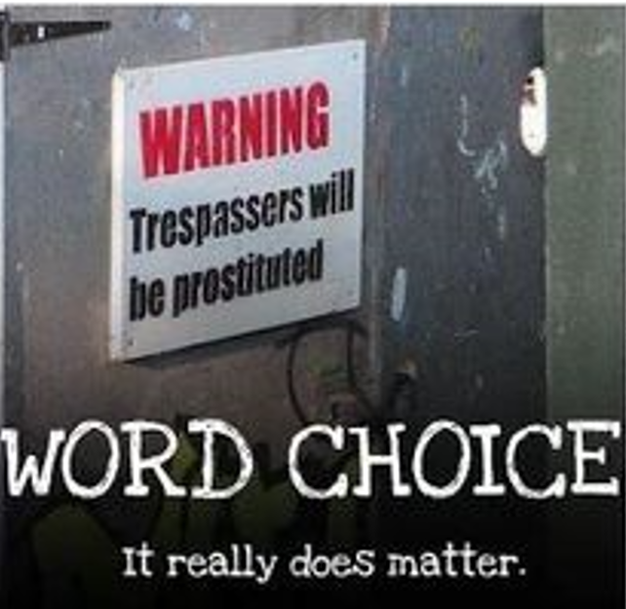
Word Choice Matters
Notes:
All Word Matter?
Either these people cannot spell.
Or they put the words that way on purpose.
No other conclusion.

Slide 3
Words Matter
Suspect interviewed after recent murder of wife.
"I took my beautiful wife of 31 years out to dinner"
vs.
"I took the old hag out to dinner"
Notes:
You can tell both statements either show a fondness of distaste of the wife.

Slide 4
Words Matter
Upon asking a suspect how the murder of the victim made him feel
"I was sorry to see her dead."
Could be how that person typically talks
Or
did he actually see her dead?

Slide 5
Gospel of Mark
Several early church leaders say gospel of Mark was a book where Mark wrote what Peter dictated to him.
Papias (AD 70) said that Mark penned his gospel in Rome as Peter's scribe:
"Mark, having become the interpreter of Peter, wrote down accurately, though not indeed in order, whatsoever he remembered of the things said or done by Christ."
Irenaeus (AD 115) was a student of Ignatius and Polycarp (2 students of the apostle John) who also repeated the claim.
Justin Martyr(AD 103) and Clement of Alexandria (AD 150) said the same.
Notes:
-Papias -
ancient bishop of Hierapolis in western Turkey named Papias (AD 70)
-Polycarp (eventual bishop in modern day Lyon, France)
---
We will demonstrate how Forensic Statement Analysis can be used to show that Peter was the eyewitness behind the gospel of Mark and not just take the word of these several church leaders

Slide 6
Forensic Statement Analysis
Examination of word choice, structure, and content of a person’s written or spoken statement to determine whether it is truthful or deceptive.
Notes:
----
Other FSA tactics:
-if someone slips between past and present tense.
-What testimony do they spend the most time on and the least?
-Figure out why certain details are given in high or low quantities.

Slide 7
FSA (Gospel of John)
Why does John refer to Mary as “Jesus’ mother”, but not by her actual name?
John chapter 19
Jesus entrusted Mary to John, to take care of her as his own mother and for John to be as her son
Seems reasonable John would be uncomfortable calling Mary by her formal name “Mary”

Slide 8
Forensic Statement Analysis(Mark)
Study of how someone wrote or said something
Mark mentions Peter with prominence
Peter mentioned frequently (26 times)
Matthew only mentions Peter 3 times
Mark wrote most with most familiarity about Peter
Peter is 1st and last apostle mentioned
Notes:
prominence - .
Mark used either of Peter's name "Simon" or "Peter", which is similar to only using a person's first name instead of their full name, which usually
is done by someone who knows you with great familiarity.
Would be similar to us calling Peter “Pete”
or Moses “Moe”.
The reason some people find it humorous when someone yells “Biiiilllll” when having a computer problem is because none of us knows Bill Gates personally.

Slide 9
Forensic Statement Analysis(Mark)
Mark paid Peter the utmost respect than any other gospel writer did.
failed to include part where Peter sunk in to the water when failing to have faith in Jesus at the sea of Galilee.
did not include the account where Peter failed to believe Jesus by casting on the other side of the boat.
included wording that was kindest to Peter in the passage where Jesus says “Get behind me Satan!” in response to Peter’s comment

Slide 10
Forensic Statement Analysis(Mark)
Some seemingly unimportant details about Peter are mentioned.
Only Mark tells us that "Simon and his companions" were the ones who looked for Jesus when He was praying in a solitary place (Mark 1:35-37).
Mark is the only gospel to tell us that Peter was the first to draw Jesus attention to the withered fig tree in Mark 11:20-21 (compared to MATT 21:18-19).
Only Mark tells us that Capernaum was Peter's hometown.

Slide 11
Forensic Statement Analysis(Mark)
Peter’s teaching style is in the same in both the book of
Acts (1:21-22 and 10:37-41)
and Mark
Peter’s teaching did not focus details of Jesus’ personal life, but instead focused on Jesus' public life, death, resurrection, and ascension

Slide 12
Forensic Statement Analysis(Mark)
Mark overall gave more personal titles to Peter, more priority in the narrative, and included information related to Peter.
Notes:
Witnesses will always have doubt cast on their reliability from the opposition, so it is important to be able to match your witnesses to the evidence.

Slide 13
FSA – how it was said
With FSA methods, we have added yet another layer of credibility to the gospel accounts
Anyone can do FSA assessments
Helps us analyze human witness testimony for truthfulness
Notes:
FSA – Forensic Statement Analysis
One layer is not strong by itself, but as we build upon the various evidences, the case will become stronger
Studying the gospel account texts forensically might seem rather foreign to most people, but we are all capable of it.
-If you had a letter written to you by your significant other or ardent admirer, wouldn't you 'read between the lines' and scrutinize each and every word?

Slide 14
for more information visit:
www.ColdCaseChristianity.com

